Slide 1
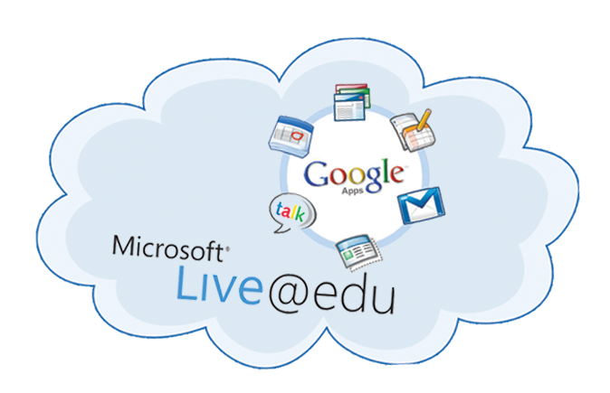
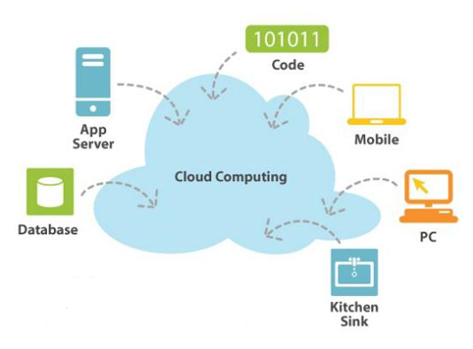
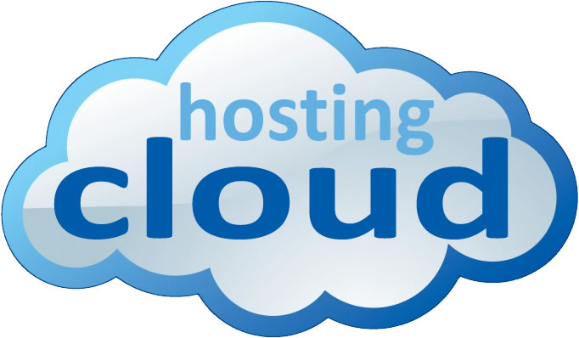
Cloud computing
Tahani aljehani

Slide 2
Before talking about cloud computing we should know about the virtualization which is the infrastructure of cloud computing

Slide 3
Why virtualization
Server computers -- machines that host files and applications on computer networks
Problems :
Most servers use only a small fraction of their overall processing capabilities.
Another problem is that as a computer network gets larger and more complex, the servers begin to take up a lot of physical space

Slide 4
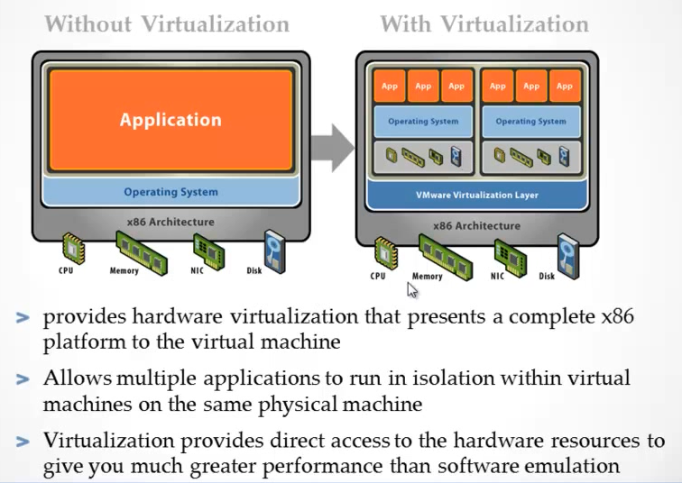
What is Virtualization
Notes:
convert one physical server into multiple virtual machines. Each virtual server acts like a unique physical device, capable of running its own operating system (OS)

Slide 5
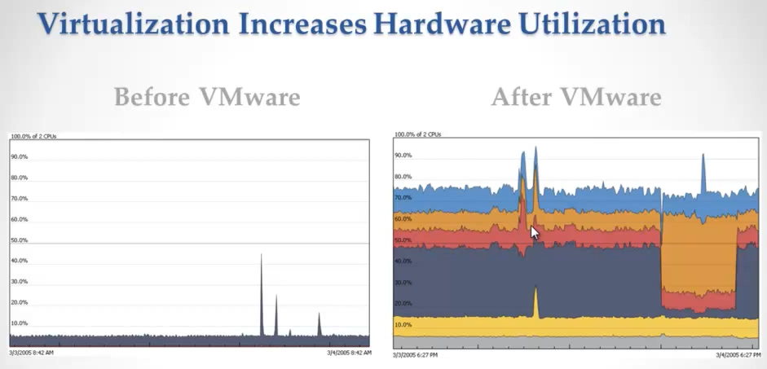
Hardware utilizations

Slide 6
Key proprieties of virtual machine

Slide 7
Virtualization Infra

Slide 9
Notes:
An emerging trend in server virtualization is called migration. Migration refers to moving a server environment from one place to another. With the right hardware and software, it's possible to move a virtual server from one physical machine in a network to another. Originally, this was possible only if both physical machines ran on the same hardware, operating system and processor. It's possible now to migrate virtual servers from one physical machine to another even if both machines have different processors, but only if the processors come from the same manufacturer.

Slide 13
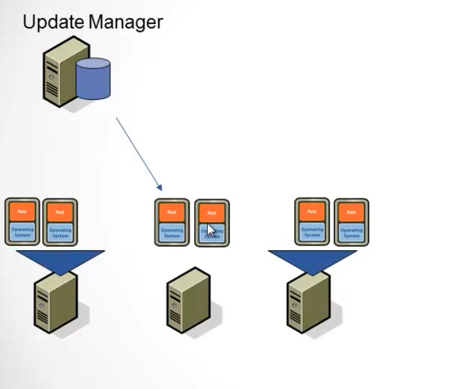

Slide 14
Introduction to cloud computing
When you want to access your email you open your web browser, go to the email client, and log in.
Your email is not housed on your physical computer
you access it through an internet connection, and you can access it anywhere.
If you are on a trip, at work, or down the street getting coffee, you can check your email as long as you have access to the internet.
An email client is similar to how cloud computing works.

Slide 15
Introduction to cloud computing
The cloud makes it possible for you to access your information from anywhere at any time.
While a traditional computer setup requires you to be in the same location as your data storage device.
The cloud removes the need for you to be in the same physical location as the hardware that stores your data.
Your cloud provider can both own and house the hardware and software necessary to run your home or business applications.

Slide 16
Introduction to cloud computing
This is especially helpful for businesses that cannot afford the same amount of hardware and storage space as a bigger company.
Small companies can store their information in the cloud, removing the cost of purchasing and storing memory devices.
Remove the cost for hiring programmers and the time for building the application

Slide 17
Introduction to cloud computing
In the cloud computing model, computing power, software, storage services, and platforms are delivered on demand to external customers over the internet.

Slide 18
What is Cloud Computing ?
Cloud computing is a method of providing a set of shared computing resources that include applications, computing, storage, networking, development and deployment platforms, and business process.
Cloud computing turns traditionally soiled computing assets into a shared pool of resources that are based on an underlying Internet foundation.
Cloud computing makes these resources easier to use by supporting a self-service model so resources can be acquired or provisioned based on need or assigned business rules

Slide 19
NIST Definition of Cloud Computing
July 5, 2011:
The NIST Definition of Cloud Computing identified cloud computing as:
a model for enabling ubiquitous, convenient, on-demand network access to a shared pool of configurable computing resources (e.g., networks, servers, storage, applications, and services) that can be rapidly provisioned and released with minimal management effort or service provider interaction

Slide 20
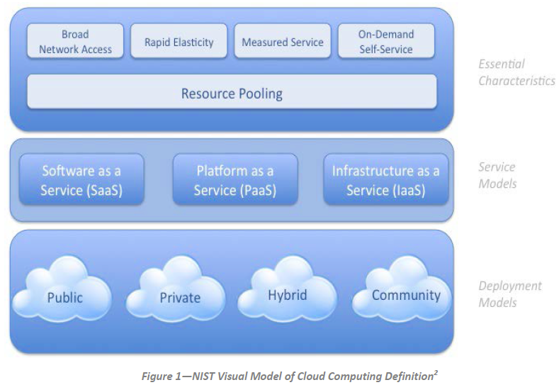
Notes:
NIST defines cloud computing by describing five essential characteristics, three cloud service models (delivery models), and four cloud deployment models. They are summarized in visual form in this figure and explained in detail below.

Slide 21
Cloud computing often leverages
Cloud computing often leverages:
Massive scale
Homogeneity
Virtualization
Resilient computing
Low cost software
Geographic distribution
Service orientation
Advanced security technologies
Notes:
Resiliency is the ability of a server, network, storage system, or an entire data center, to recover quickly and continue operating even when there has been an equipment failure, power outage or other disruption

Slide 22
Five Essential Cloud Characteristics
On-demand self-service
Broad network access
Resource pooling
Location independence
Rapid elasticity
Measured service (Pay per use)
Notes:
Broad network access: Capabilities are available over the network and accessed through standard mechanisms that promote use by heterogeneous thin or thick client platforms (e.g., mobile phones, tablets, laptops and workstations)
Elasticity is defined as the ability to scale resources both up and down as needed. To the consumer, the cloud appears to be infinite, and the consumer can purchase as much or as little computing power as they need.

Slide 23
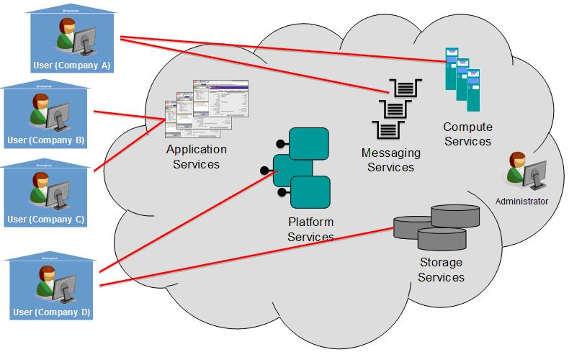
Multi-tenancy?
Although not an essential characteristic of Cloud Computing we should mention

Slide 24
Multi-tenancy?
Multi-tenancy is an architecture in which a single instance of a software application serves multiple customers.
Each customer is called a tenant.
Tenants may be given the ability to customize some parts of the application, such as color of the user interface ( UI) or business rules, but they cannot customize the application's code.

Slide 25
Types of services
With the essential characteristics of Cloud Computing defined, it is critical to understand the types of services that are available in a Cloud Computing model.
The NIST definition of Cloud Computing defines three service models:
Cloud Infrastructure as a Service (IaaS)
Cloud Platform as a Service (PaaS)
Cloud Software as a Service (SaaS).

Slide 26
Software as a Service (SaaS).
The capability provided to the consumer is to use the provider’s applications running on a cloud infrastructure2.
The applications are accessible from various client devices.
The consumer does not manage or control the underlying cloud infrastructure
Used by end user

Slide 27
Platform as a Service (PaaS).
The capability provided to the consumer is to deploy onto the cloud infrastructure consumer-created or acquired applications created using programming languages, libraries, services, and tools supported by the provider
Used by developers

Slide 28
Infrastructure as a Service (IaaS).
The capability provided to the consumer is to provision processing, storage, networks, and other fundamental computing resources
where the consumer is able to deploy and run arbitrary software, which can include operating systems and applications.
The consumer does not manage or control the underlying cloud infrastructure but has control over operating systems, storage, and deployed applications; and possibly limited control of select networking components (e.g., host firewalls).
Used by network architecture

Slide 29
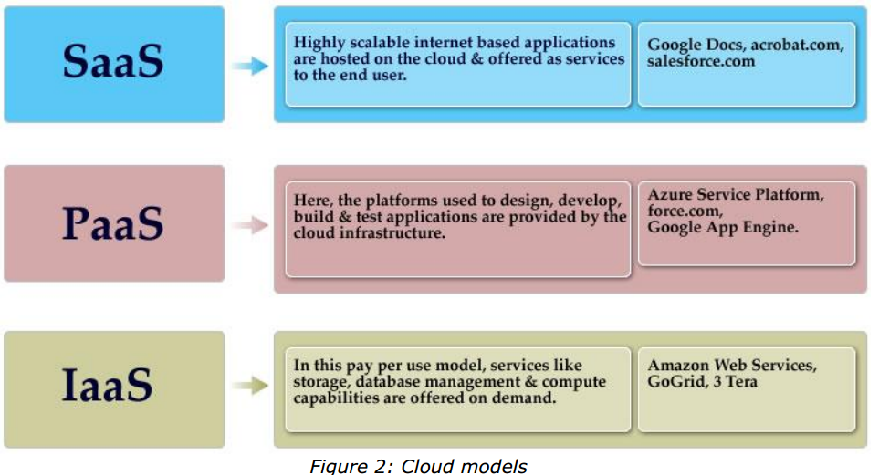
Types of service

Slide 30
Four Cloud Deployment Models
Private cloud
enterprise owned or leased
Community cloud
shared infrastructure for specific community
Public cloud
Sold to the public, mega-scale infrastructure
Hybrid cloud
composition of two or more clouds
Notes:
Regardless of the service model utilized (SaaS, PaaS, or IaaS) there are four deployment models
for cloud services, with derivative variations that address specific requirements:
• Public Cloud. The cloud infrastructure is made available to the general public or a large
industry group and is owned by an organization selling cloud services.
• Private Cloud. The cloud infrastructure is operated solely for a single organization. It
may be managed by the organization or a third party, and may exist on-premises or offpremises.
`
supports a specific community that has shared concerns (e.g., mission, security
requirements, policy, or compliance considerations). It may be managed by the
organizations or a third party and may exist on-premises or off-premises.
Example :
For example all Government organizations within the state of California may share computing infrastructure on the cloud to manage data related to citizens residing in California
• Hybrid Cloud. The cloud infrastructure is a composition of two or more clouds (private,
community, or public) that remain unique entities but are bound together by standardized
or proprietary technology that enables data and application portability (e.g., cloud
bursting for load-balancing between clouds).

Slide 31
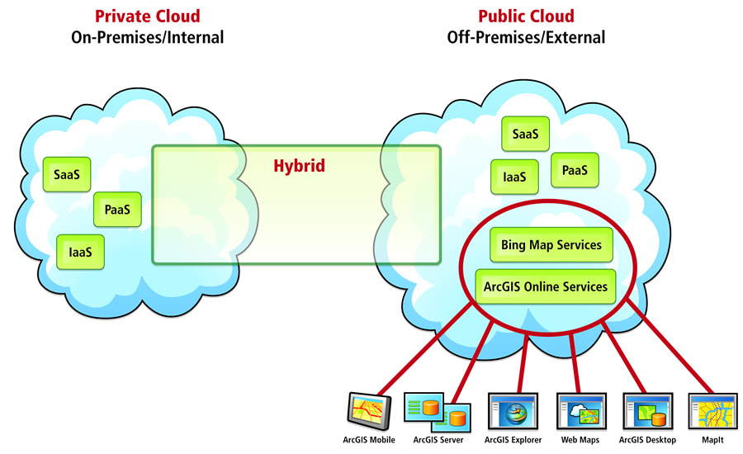
Notes:
On premise means on location, whereas off premise means remote (in the cloud).

Slide 32
NIST: Interactions between Actors in Cloud Computing
Cloud Consumer
Cloud Auditor
Cloud Broker
Cloud Provider
Notes:
Cloud Consumer Person or organization that maintains a business relationship with, and uses service from, Cloud Providers.
Cloud Provider Person, organization, or entity responsible for making a service available to Cloud Consumers.
Cloud Auditor The goal of CloudAudit is to provide cloud service providers with a way to make their performance and security data readily available for potential customers.
1. A cloud broker is a third-party individual or business that acts as an intermediary between the purchaser of a cloud computing service and the sellers of that service. In general, a broker is someone who acts as an intermediary between two or more parties during negotiations.
Cloud Carrier The intermediary that provides connectivity and transport of cloud services from Cloud Providers to Cloud Consumers

Slide 33
Benefits of using cloud
Cost Saving
Scalability/Flexibility
Reliability
Maintenance
Mobile Accessible
Notes:
The following are some of the possible benefits for those who offer cloud computing-based services and applications:
•Cost Savings — Companies can reduce their capital expenditures and use operational expenditures for increasing their
computing capabilities. This is a lower barrier to entry and also requires fewer in-house IT resources to provide system support.
• Scalability/Flexibility — Companies can start with a small deployment and grow to a large deployment fairly rapidly, and then scale back if necessary. Also, the flexibility of cloud computing allows companies to use extra resources at peak times, enabling them to satisfy consumer demands.
• Reliability — Services using multiple redundant sites can support business continuity and disaster recovery.
• Maintenance — Cloud service providers do the system maintenance, and access is through APIs that do not require application installations onto PCs, thus further reducing maintenance requirements.
• Mobile Accessible — Mobile workers have increased productivity due to systems accessible in an infrastructure available from anywhere.

Slide 34
Security in the cloud
The information housed on the cloud is often seen as valuable to individuals with malicious intent.
There is a lot of personal information and potentially secure data that people store on their computers, and this information is now being transferred to the cloud.

Slide 35
Security in the cloud
The first thing you must look into is the security measures that your cloud provider already has in place.
What encryption methods do the providers have in place?
What methods of protection do they have in place for the actual hardware that your data will be stored on?
Will they have backups of my data? Do they have firewalls set up?
If you have a community cloud, what barriers are in place to keep your information separate from other companies?
Notes:
cloud provider : google , amazon , IBM

Slide 36
Real examples
Amazon EC2
Google App Engine
Microsoft Azure Service

Slide 37
Amazon EC2
With Amazon Elastic Compute Cloud (EC2), you need to set up an Amazon Machine Image – a virtual machine running Windows (or Linux)
Install applications, libraries, and data that you need.
one processor, 1.7GB of RAM, 160GB of storage – is available for as little as £700 per year
4 processor 7.5 GB of RAM, 850GB storage – works out to £2800 per year

Slide 38
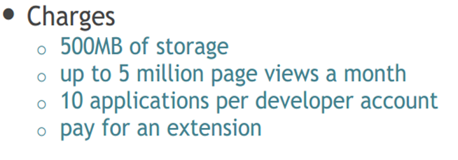
Google App Engine
To build a Google App Engine website, you set up an account and get access to the App Engine
Software Development Kit (SDK), which allows you to write App Engine-compatible software.
Unfortunately the platform does not support Microsoft only Python or Java must be used.

Slide 39
Windows Azure
and as you’d expect it is slightly more focused on the use of .NET components (it natively supports ASP.NET). It is also set up to support SQL Server databases
$1120, or around £700 per year

Slide 40
Gide VS cloud
The difference between a cloud and a grid can be expressed as below:
Resource distribution: Cloud computing is a centralized model whereas grid computing is a decentralized model where the computation could occur over many administrative domains.
Ownership: A grid is a collection of computers which is owned by multiple parties in multiple locations and connected together so that users can share the combined power of resources. Whereas a cloud is a collection of computers usually owned by a single party.

